Slide 1

Dashboard Blueprint
Primary tools used
Tableau
Excel
Sql
Jupyter Notebooks
Python

Slide 2
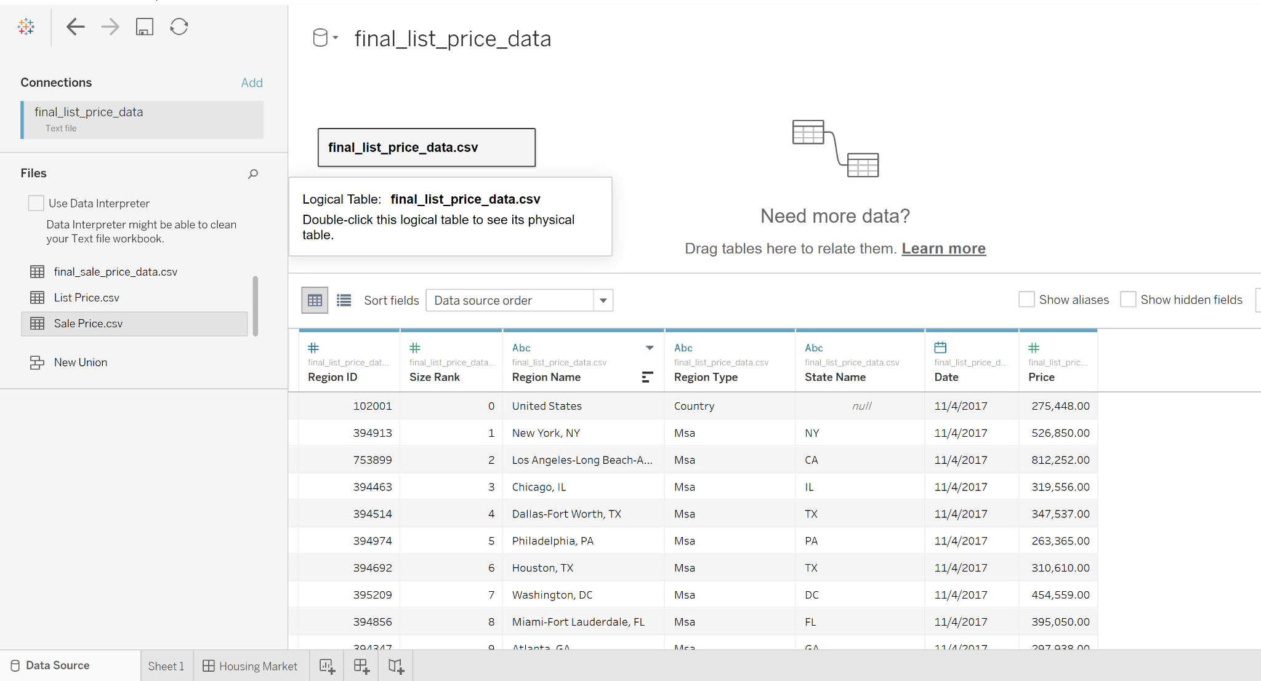
Tableau
Our tools for data visualization will be taking place primarily in Tableau.

Slide 3
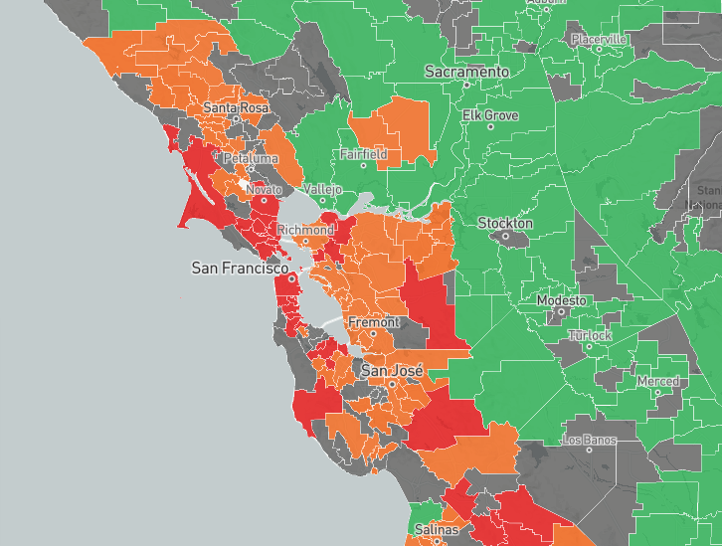
Interactive Elements
We plan to utilize interactive elements within our visualizations, such as heat maps to show population density.

